Slide 1
Practical's Syntax and Example
Day 1 to 6

Slide 2
Create Table
Syntax:-
CREATE TABLE table_name(
Column_name 1 Datatype(Size),
Column_name 2 Datatype(Size),
Column_name N Datatype(Size) );
Example:-
Create Table Student(
Rollno number(2),
Name Varchar2(10) );

Slide 3
Create table Primary key and Foreign key
Syntax:-
CREATE TABLE Table _name(
Column_Name DataType (Size)Primary key,
Column_Name DataType(Size) References Table_Name(Column_name) );
Example:-
Create Table Teacher(
T_id Number(3) Primary key,
T_Name varchar2(10),
Roll_no number(2) References Student(Rollno) );

Slide 4
Constraints
There are two types of constrains that can be applied to data being inserted into a Oracle table.
I/O Constraint: – Can be defined at the table level or at the column level
Primary Key Constraint (Unique + Not Null)
Foreign Key Constraint
Unique Constraint (Can allow multiple Null values)
Business Rule Constraint:
NOT NULL Constraint – Defined at column level
Check Constraint – Defined at column level or at table level
Default Value – Defined at the column level

Slide 5
Example to create a table with all constraints
Create table emp (
empno number(3) primary key,
Ename varchar(25) NOT NULL,
Contact number(10) Unique,
Gender char(1) check (gender in (‘M’, ‘F’)),
DeptNo number(2) references Department(Dno),
city varchar(25) default ‘Ahmedabad’
);

Slide 6
Example to create a table with all constraints defined at table level
Create table stud (
rollno number(3),
name varchar(25) NOT NULL,
contact number(10),
gender char(1),
course number(2),
city varchar(25) default ‘Ahmedabad’,
check (gender in (‘M’, ‘F’)),
primary key(rollno),
unique (contact),
foreign key (course references Courses(CourseCode)) on delete cascade
);

Slide 7
Insert values in Table
Syntax:-
INSERT INTO Table_name VALUES(Col1, Col2,………Col3);
Example:-
Insert into Student Values(&Rollno,’&name’);
Insert into Student Value(1,’Xyz’);

Slide 8
Display All Records of Tables
Syntax:-
SELECT * FROM Table_name;
Example:-
Select * from Student;
Select Rollno from Student;
Select Rollno,Name from Student;

Slide 9
Display Only Structure Of table
Syntax:-
DESC Table_Name;
Example:-
Desc Student;

Slide 10
Where Clause
Syntax:-
Select * from table_name WHERE Column_name = Value;
Example:-
Select * from Student WHERE Rollno =5;
Select Name from Student WHERE Name LIKE ‘A%’ AND Name Like ‘B%’;
Condition 1
Condition 1 Condition 2

Slide 11
Create Table from another Table
Syntax:
CREATE TABLE New_Table_Name AS SELECT * FROM Old_Table_Name;
Example:
create table client as select * from client_master;

Slide 12
Insert Records from another Table
Syntax:-
INSERT INTO NEW_TABLE_NAME SELECT * FROM OLD_TABLE_NAME;
Example:-
insert into client select * from client_master;

Slide 13
Delete Records from Table
Syntax:-
DELETE FROM Table_Name WHERE Column_name= ‘Value’;
Example:-
Delete from student WHERE Rollno =1;
Delete from Student WHERE Name =‘xyz’ AND Name =‘pqr’;

Slide 14
Update table Records
Syntax:-
UPDATE TABLE_NAME SET Column_Name =‘ New value’ WHERE Column_Name= ‘Old_ value’;
Example:-
Update Student SET Name =‘jenny’ WHERE Name =‘xyz’;
Update EMP SET salary = 50000 WHERE salary > 20000;

Slide 15
Destroying Table
Syntax:-
TRUNCATE TABLE Table_name;
DROP TABLE Table_name;
Example:-
Truncate Table Emp;
Drop Table student;
Truncate not Destroy structure of table but Drop Destroy Structure of Tablel.

Slide 16
Modifying Structure
Add Column
Syntax:-
ALTER TABLE Table_name ADD New_Column_Name DataType(Size);
Example:-
Alter Table Student ADD Marks number(2);
Drop Column
Syntax:-
ALTER TABLE Table_Name DROP COLUMN Column_Name;
Example:-
ALTER Table Emp DROP COLUMN Adresss1;

Slide 17
Modifying Structure
Modifying Existing Column
Syntax:-
ALTER TABLE Table_name MODIFY Column_name DataType(Size);
Example:-
Alter table Student Modify Rollno number(3);
Rename Existing Column
Syntax:-
ALTER TABLE Table_Name RENAME COLUMN Old_column_name TO New_Column_name;
Example:-
Alter Table Student RENAME COLUMN Rollno TO Rno;

Slide 18
Rename Table
Syntax:-
RENAME Old_Table_Name TO New_Table_Name;
Example:-
Rename Student TO Student_Master;

Slide 19
Order By
.
The ORDER BY clause in SQL is used to sort the result set in ascending or descending order.
Syntax:-
SELECT column1, column2, ...
FROM table
ORDER BY columnA, columnB, ...;
Example:-
- orders all rows from Customers in ascending order by country
SELECT *
FROM Customers
ORDER BY country;

Slide 20
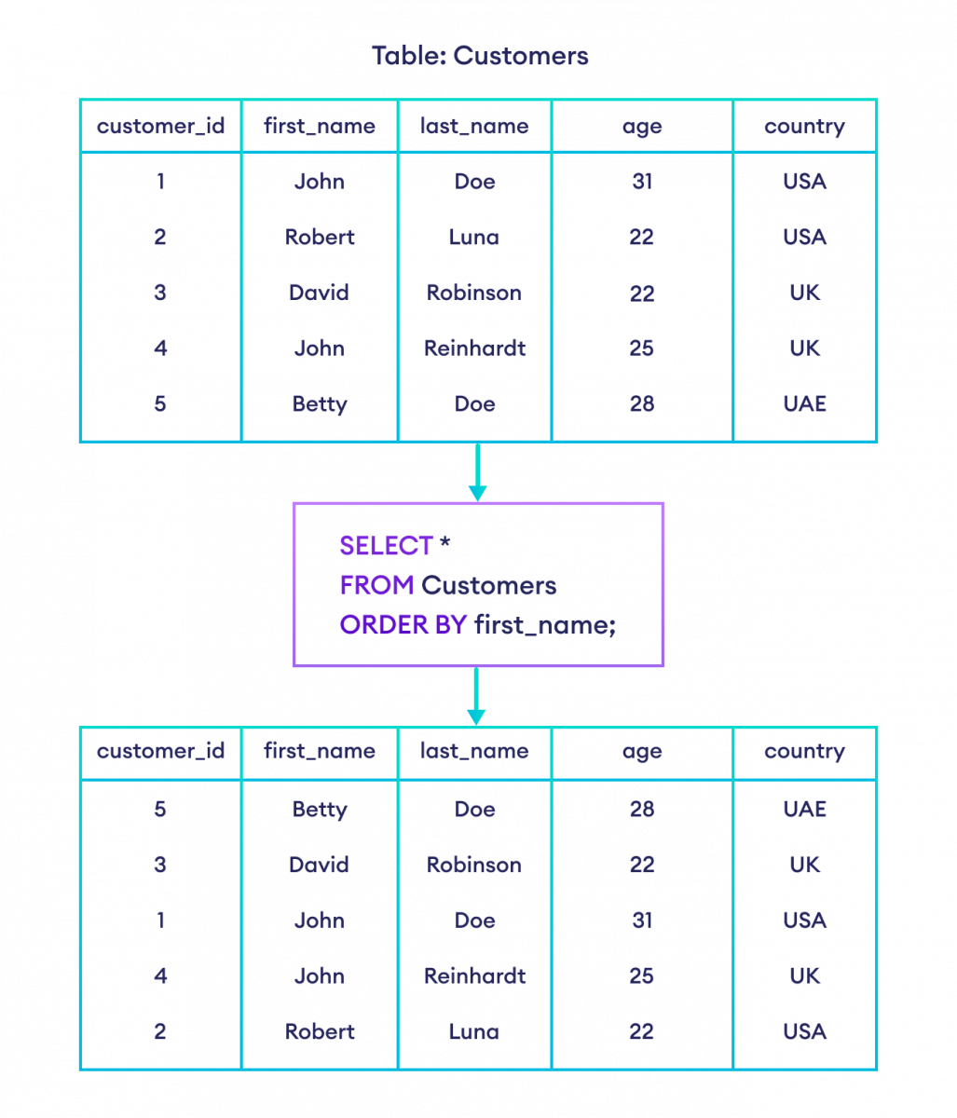

Slide 21
Group By
n
SQL, the GROUP BY clause is used to group rows by one or more columns.
Syntax:-
SELECT column1, column2, ...
FROM table
GROUP BY columnA, columnB, ...;
Example:-
select the item column and the count of order ids from the Orders table
-- group them by the item column
SELECT COUNT(order_id), item
FROM Orders
GROUP BY item;

Slide 22
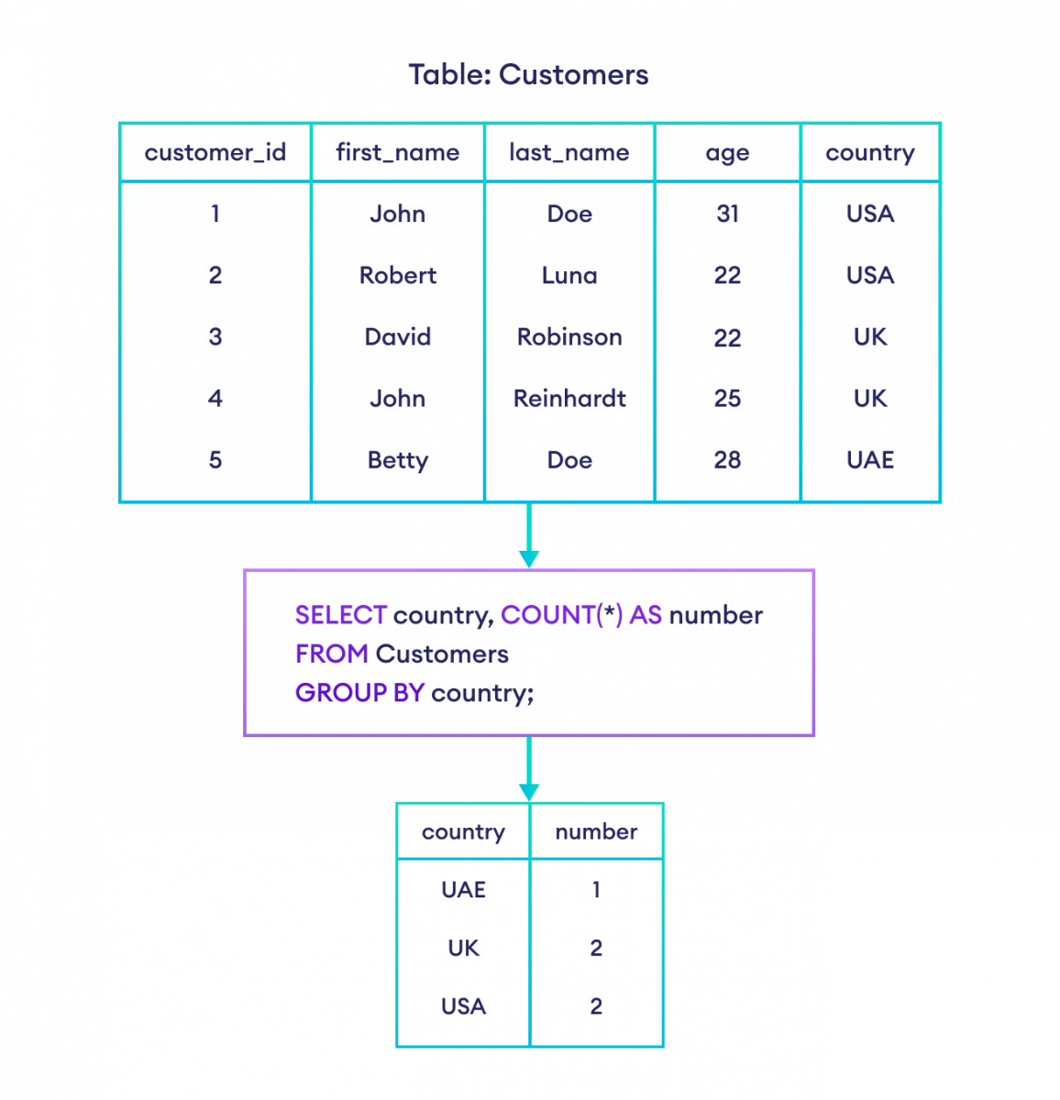

Slide 23
Having Clause
Syntax:-
SELECT AggFunc(column), extra_columns
FROM table
GROUP BY target_column
HAVING condition;
Explation Of Syntax:-
AggFunc(column) refers to any aggregate function applied to a column
extra_columns are other extra columns to filter
GROUP BY groups the data by target_column
HAVING condition compares the column to certain conditions that require filtering

Slide 24
Having Clause
Example:-
-- select the count of customer ids greater than one and their corresponding country
SELECT COUNT(customer_id), country
FROM Customers
GROUP BY country
HAVING COUNT(customer_id) > 1;

Slide 25
